Slide 1

Worship in Pink
Together, we will create a world without breast cancer
Notes:
*The notes section of each slide will contain your script in bold print*
[Insert a personalized welcome for your audience- things to include: who you are, why this topic is important to you]
At the end of this presentation, you will be able to: state the four breast self-awareness messages and name one action item associated with each, name the 2 most common risk factors for breast cancer, know the services that Komen offers as part of their Patient Care Center, and share this information with at least one person you care about.

Slide 2
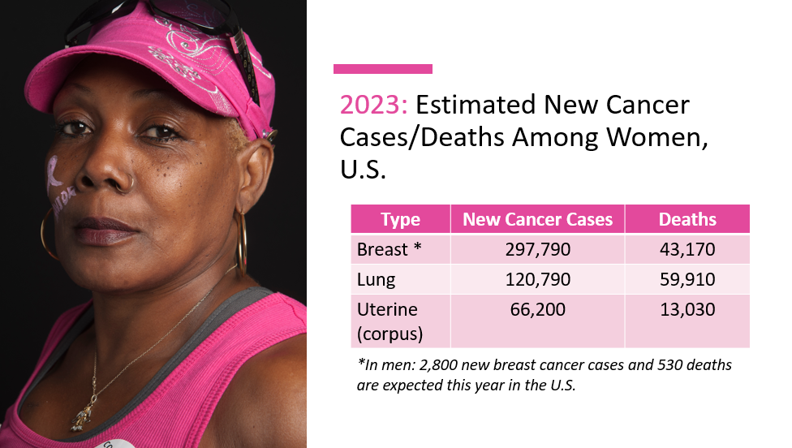
Notes:
Here, you can see that breast cancer is the leading cancer diagnosed in women in the U.S., followed by lung and uterine cancer. This year alone, 297,790 women are expected to be diagnosed with breast cancer, and over 43,000 are expected to lose their lives to this disease.
And, breast cancer isn’t something that only affects women. About 1% of all cases of breast cancer are found in men, which is why it is important that everyone knows about the signs and symptoms of breast cancer.

Slide 3
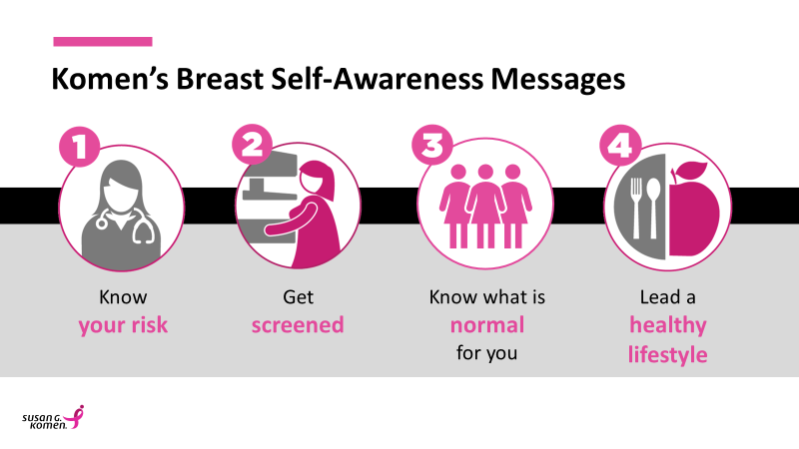
Notes:
While we don’t really know what causes breast cancer, we do know that there are some actions you can take that may reduce your risk of breast cancer. Because the signs for breast cancer are not the same for all people, it’s important to know these four key self-awareness messages and take action.
They are:
1. Know your risk
2. Get screened
3. Know what is normal for you
and
4. Make healthy lifestyle choices.
I will touch on each of them in the next few slides

Slide 4
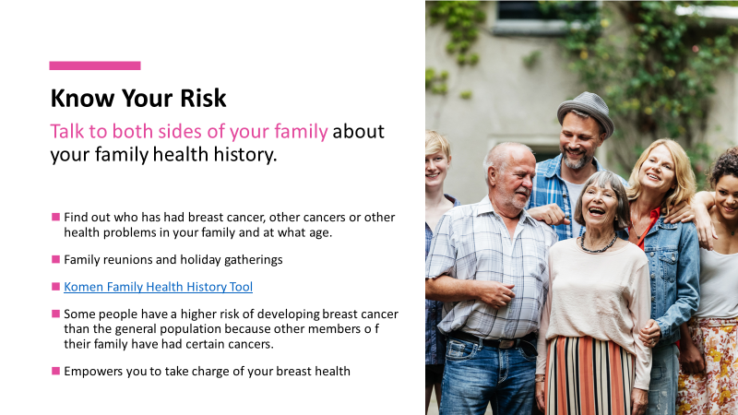
Notes:
To know your risk, you must talk to both sides (maternal and paternal) of your family about your family health history. Find out who has had breast cancer or other cancers or other health problems in your family. This information can be used to help you learn about your risk of breast cancer. Use opportunities like family gatherings (reunions, holidays) to kickstart these conversations. Komen has a My Family Health History Tool online to help you gather this information. Some people have a higher risk of developing breast cancer than the general population because other members of their family have had particular cancers. Knowing your family health history can empower you to begin to take charge of your breast health.

Slide 5
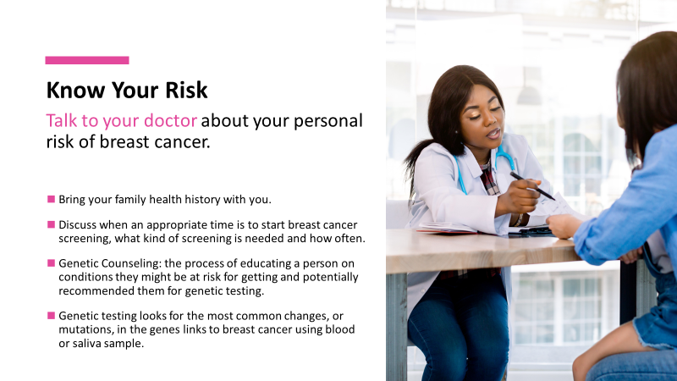
Notes:
Talk to your doctor about your personal risk of breast cancer. Bring your family health history with you and then discuss when an appropriate time is to start, what kind of screening is needed and how often to have them. If your family health history shows cancers and other health problems, then genetic counseling and testing may be suggested. Genetic counseling can help you determine whether genetic testing would give you useful information about you and your family's risk of breast and other cancers.

Slide 6
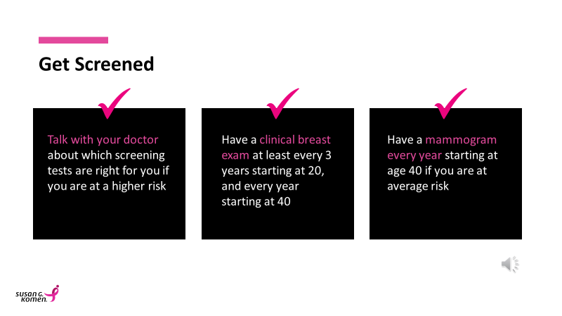
Notes:
The second is get screened
Again- when you talk to your doctor to understand your risk, it is also important to talk about when to get screened.
If you are at a higher risk, talk with your doctor about which screening tests are right for you and when they should begin.
If you are at average risk, it's important to have a clinical breast exam at least every 3 years staring at age 20, and every year starting at age 40. It is also important that women at average risk have a mammogram every year starting at age 40.

Slide 7

Know What is Normal for You
Know how your breasts normally look and feel
and report any change to your doctor.
Notes:
The 3rd is
Know what is normal for you
It's important that you know how your breasts normally look and feel and that you report any changes you see or feel to your doctor. Men, this applies to you too!
On the next slide, I’ll give you a few examples of what to look out for.

Slide 8
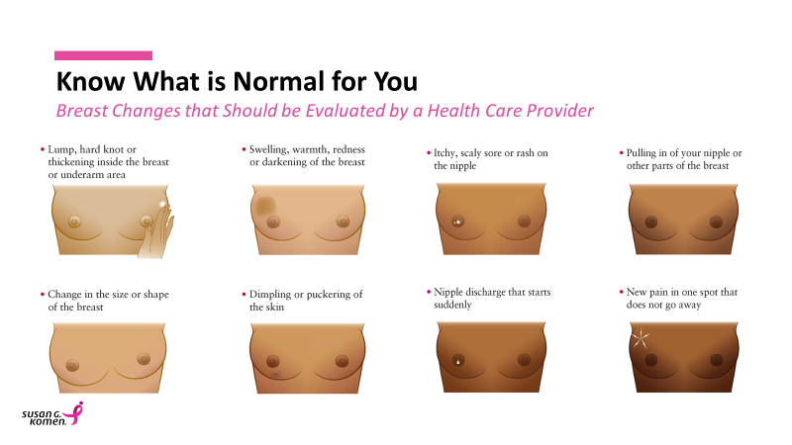
Notes:
The warning signs of breast cancer are not the same for all people. Society has done a good job of informing people to follow up with their doctors if they find a lump in their breast.
Visual changes, however, can also be the first sign that something is going on in the breast and should be checked.
Here are a few warning signs to look out for – and to report to your doctor if you notice any of them.
*If you have a pointer, it may be helpful to point each one out as you go*
A lump, hard knot or thickening inside the breast or underarm area
Swelling, warmth, redness or darkening of the breast
A change in the size or shape of the breast
Dimpling or puckering of the skin
An itchy, scaly sore or rash on the nipple
A pulling in of the nipple or other parts of the breast
Any nipple discharge that starts suddenly
Or a new pain in one spot that doesn’t go away
It is important to remember that it is CHANGES we are concerned about. For instance, some people have that pulling in of the nipple and that is normal for them and many women have one breast that is slightly larger than the other. If you, however, notice a change, that should be reported.

Slide 9
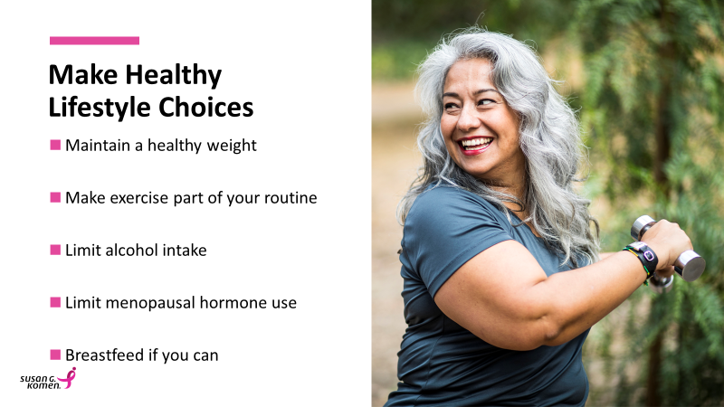
Notes:
The final key breast self- awareness message is to Make Healthy Lifestyle Choices. These lifestyle choices can help lower your risk of breast cancer.
Maintain a health weight
Make exercise part of your routine
Limit alcoholic intake to less than 1 drink a day for women and fewer than 2 drinks a day for men.
Limit menopausal hormone use, which is linked to an increased risk of developing breast cancer.
Breastfeed if you can. Women who breastfeed have a lower risk of breast cancer, especially before menopause, than women who don’t breast feed.
These healthy lifestyle choices can help reduce your risk of breast cancer but it's important to note, cancer tends to be caused by a combination of factors. Some things we may be able to control (such as exercise). Others are out of our control (such as age) and some are still unknown.
So to recap Komen’s 4 key messages were: (either ask the audience to recite them back to you or relist them yourself)
Know your risk
Get screened
Know what is normal for you
Lead a healthy lifestyle

Slide 10
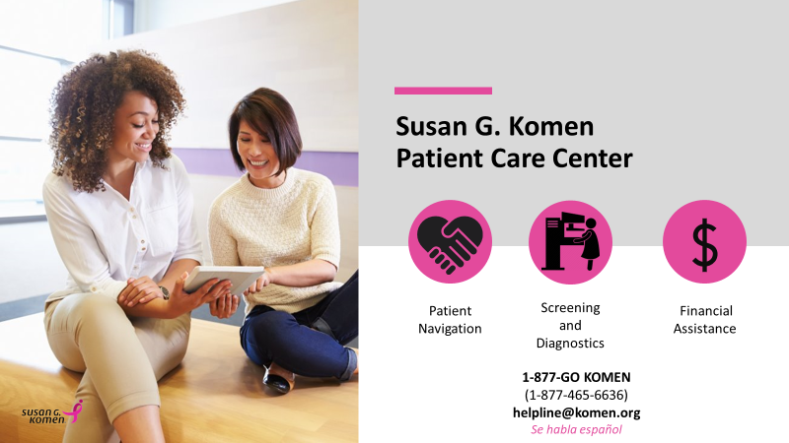
Notes:
Now that you know more about how to take action to improve your own breast health, let's talk about how Komen is providing real support, right now through the Susan G. Komen Patient Care Center.
The Komen Patient Care Center is a direct patient support program staffed with patient navigators who support people every step of the way through their breast health journey, providing: information and education, emotional support, access to screening and diagnostic services, and financial assistance.
The Patient Care Center is staffed by a world class, highly trained team that is as diverse as the patients they serve, including oncology social workers, bilingual representatives and even breast cancer survivors.
The Patient Care Center breaks down geographic barriers by being available nationwide and it is built on a health equity foundation that recognizes that the needs of each person are unique, requiring personalized care and support. They stay with people for as long as they need them to. Sometimes that means one day, but others require longer support. All services can be accessed by calling into the Breast Care Helpline at 1-877-465-6636 or emailing helpline@komen.org.

Slide 11


Faith & Breast Cancer
“…Faith without works is dead.”
Notes:
(Optional Slide to include)
While there is nothing we can do to guarantee that we never get breast cancer, we must do our part to take the proper steps to lower our risk. Our faith can provide us with the means to cope and reach a deeper kind of inner healing.
Research has showed that there is a significant relationship between praying and life expectancy. In the event of a diagnosis, faith is known as a complementary method of treatment. When coupled together with modern treatment methods, it seems that it can have a good effect. Faith without works is dead, so it is up to us to do all that we can to take control of our breast health.
(Daily spiritual experiences were associated with more self-assurance and less fear of cancer recurrence in a mixed group of cancer survivors.)

Slide 12
Thank you
Notes:
Thank you!

